Slide 1
Chapter 3
Maximum-Likelihood and Bayesian Parameter Estimation (7,10)
Problems of Dimensionality
Computational Complexity
Hidden Markov Models
Patter Classification chapter 3 part 3

Slide 2
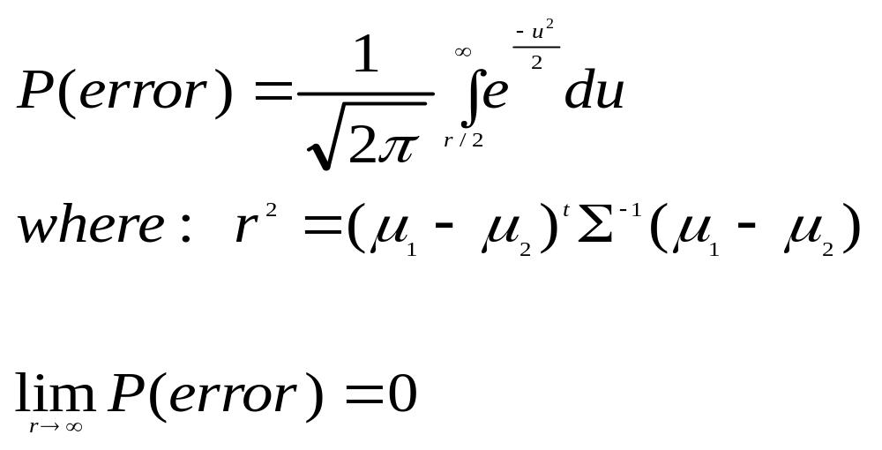
3.7 Problems of Dimensionality
Features of entries of the data (samples) are statistically independent.
    Classification accuracy depends upon the dimensionality and the amount of training data
    Case of two classes: the likehood function is multivariate normal with the same covariance
    The two classes have a same prior.
Patter Classification chapter 3 part 3

Slide 3
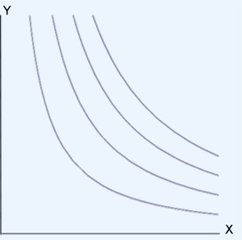
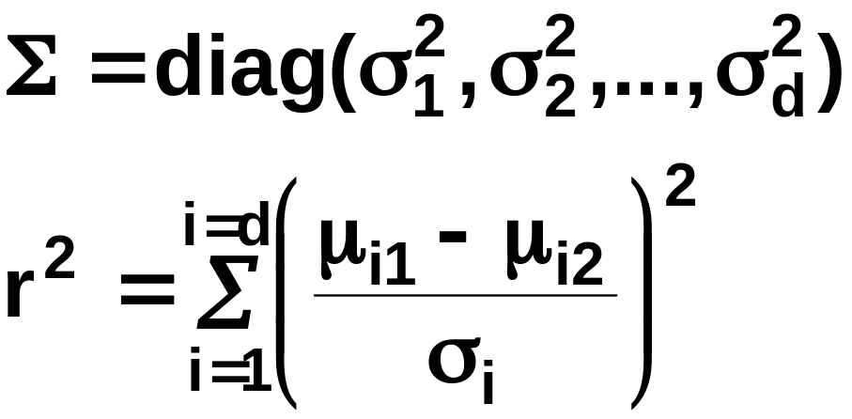
    If features are independent then:
    Most useful features are the ones for which the difference between the means is large relative to the standard deviation
    It has frequently been observed in practice that, beyond a certain point, the inclusion of additional features leads to worse rather than better performance: this is owing to complex factors.
Patter Classification chapter 3 part 3
7

Slide 4
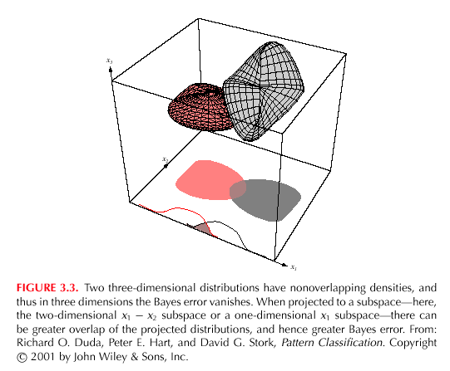
7
7
Patter Classification chapter 3 part 3
7

Slide 5
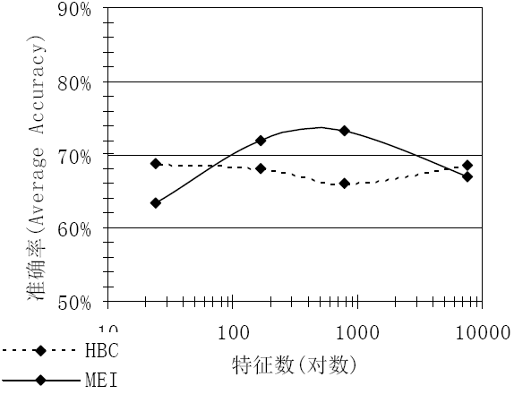


One example of document clustering
Patter Classification chapter 3 part 3

Slide 6



Too many features may be harmful
Patter Classification chapter 3 part 3

Slide 7


Way to reduce features: feature selection
Patter Classification chapter 3 part 3

Slide 8
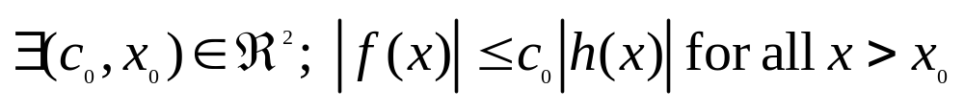
Computational Complexity
  Our design methodology is affected by the computational difficulty
    “big oh” notation
    f(x) = O(h(x)) “big oh of h(x)”
    If:
    f(x) = 2+3x+4x²
    g(x) = x²
    f(x) = O(x²)
Patter Classification chapter 3 part 3
7

Slide 9

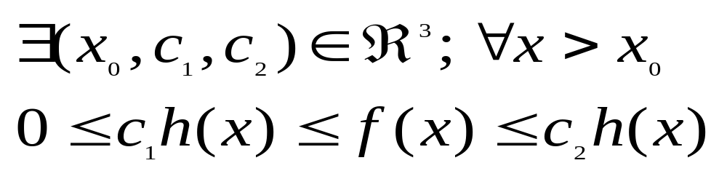
    “big oh” is not unique!
    f(x) = O(x²); f(x) = O(x³); f(x) = O(x⁴)
    “big theta” notation
    f(x) = θ(h(x))
    If:
    f(x) = θ(x²) but f(x) ≠ θ(x³)
Patter Classification chapter 3 part 3

Slide 10
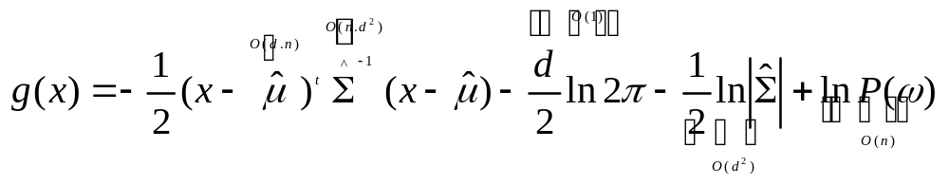
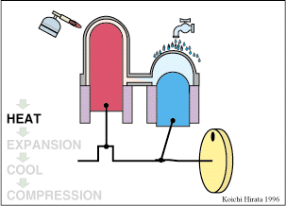
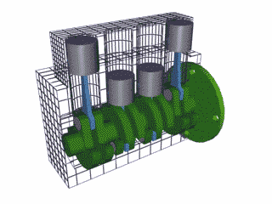
  Complexity of the ML Estimation
    Gaussian priors in d dimensions classifier with n training samples for each of c classes
    For each category, we have to compute the discriminant function
    Total = O(d²..n)
    Total for c classes = O(cd².n) ≅ O(d².n)
    Cost increase when d and n are large!
Patter Classification chapter 3 part 3

Slide 11
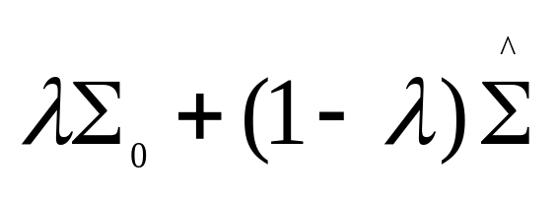

Overfitting
  Samples are inadequate
    Reduce dimensionality (select a subset of features or combine features)
    All c classes share the same covariance matrix (can better evaluate the covariance)
    Look for a better estimate for covariance matrix
    Pseudo-Bayesian estimation:
    An extreme case: statistical independence
  How to get better performance if
  statistical dependence
    Sufficient data
    Prevent overfitting
Patter Classification chapter 3 part 3

Slide 12
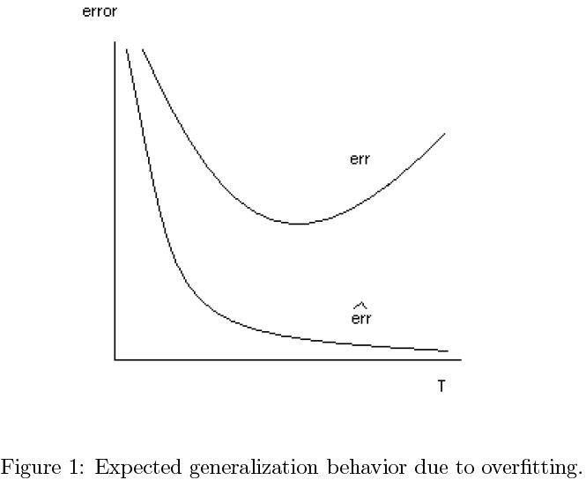
Patter Classification chapter 3 part 3

Slide 13
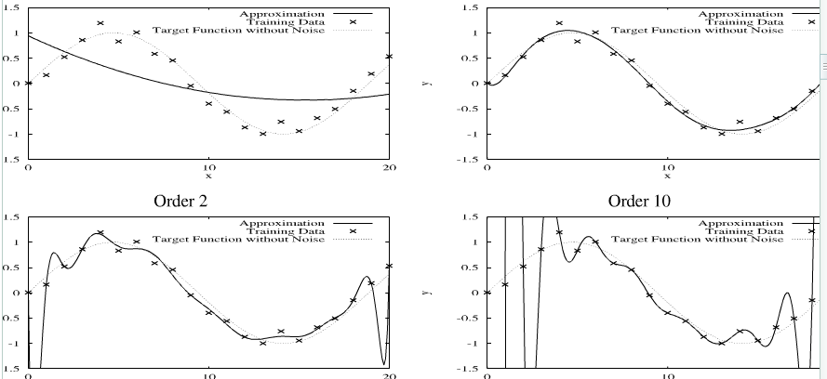
Possible overfitting in neural networks
Another example: Page 93 (In Chinese edition)
Patter Classification chapter 3 part 3

Slide 14
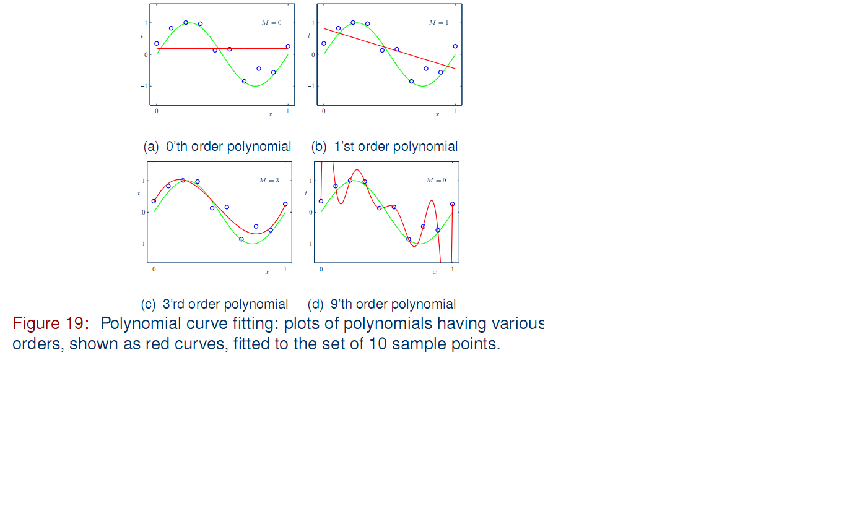
Classifiers with proper low complexity is favored
Patter Classification chapter 3 part 3

Slide 15
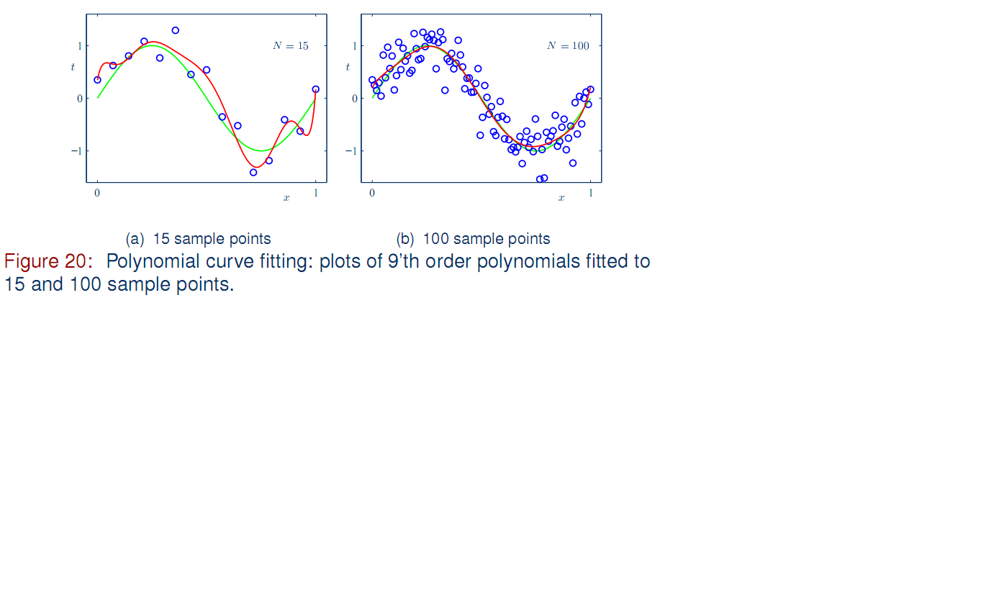
More training samples are better
Patter Classification chapter 3 part 3

Slide 16
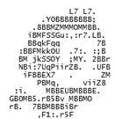


3.10 Hidden Markov Models
Goal: make a sequence of decisions
  A process that unfold in time, states at time t are influenced by a state at time t-1
  Applications: speech recognition, gesture recognition, parts of speech tagging and DNA sequencing
Patter Classification chapter 3 part 3

Slide 17
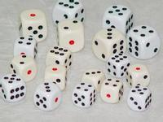
First-order Markov models
  A sequence of states at successive times
    ω^{T} = {ω(1), ω(2), ω(3), …, ω(T)}
    We might have ω⁶ = {ω1, ω4, ω2, ω2, ω1, ω4}
  The system can revisit a state at different steps and not every state need to be visited
  Our productions of any sequence is described by the transition probabilities-time independent
    P(ω_{j}(t + 1) | ω_{i} (t)) = a_{ij}
Patter Classification chapter 3 part 3

Slide 18
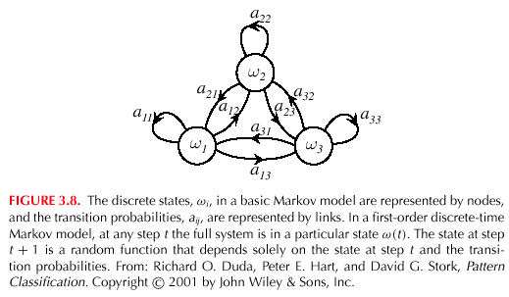
Patter Classification chapter 3 part 3
10

Slide 19


  A model θ = (a_{ij}, ω^{T})
  ω^{T} = ω⁶ = {ω1, ω4, ω2, ω2, ω1, ω4}
  P(ω^{T} | θ) = a₁₄ . a₄₂ . a₂₂ . a₂₁ . a₁₄ .
  P(ω(1) = ω_{i})
  First-order Markov Model: the probability at t+1 depends only on the sates at t
  Example: speech recognition
  “production of spoken words”
  Production of the word: “pattern” represented by phonemes
  /p/ /a/ /tt/ /er/ /n/ // ( // = silent state)
  Transitions from /p/ to /a/, /a/ to /tt/, /tt/ to er/, /er/ to /n/ and /n/ to a silent state
Patter Classification chapter 3 part 3

Slide 20


First-Order Hidden Markov Models (HMM)
  A state ω(t) emits some visible symbol v(t) , the sequence of such visible symbol is :
    V^{T} = {v(1), v(2), v(3), …, v(T)}
  In any state ω_{j}(t) we have a probability of emitting a particular visible state v_{k}(t) , ω_{j} are unobservable, such a full model is HMM
  In HMM a_{ij} is the transition probabilities among hidden states and b_{jk} is the probability of the emission of a visible state.
  a_{ij} = P(ω_{j}(t + 1) | ω_{i} (t))
  ∑ a_{ij} = 1 for all i
  b_{jk}= P(v_{k}(t) | ω_{j}(t)).
  ∑b_{jk} = 1 for all j
Patter Classification chapter 3 part 3

Slide 21
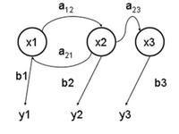
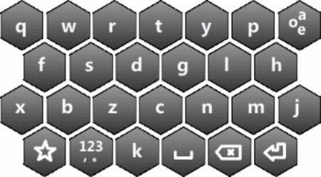
Three problems are associated with HMM
  The evaluation problem
  a_{ij,} b_{jk} probability of V^{T}
  The decoding problem
  V^{T} ωT （ analogy: listen and write） P 108
  The learning problem
  V^{T} a_{ij,} b_{jk}
一只狗（九）在狂吠
那儿有九（狗）个人
Patter Classification chapter 3 part 3

Slide 22
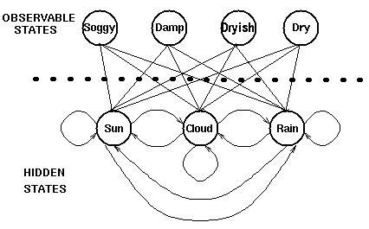
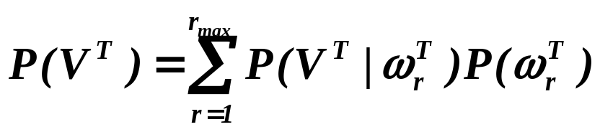
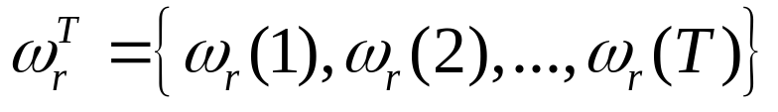
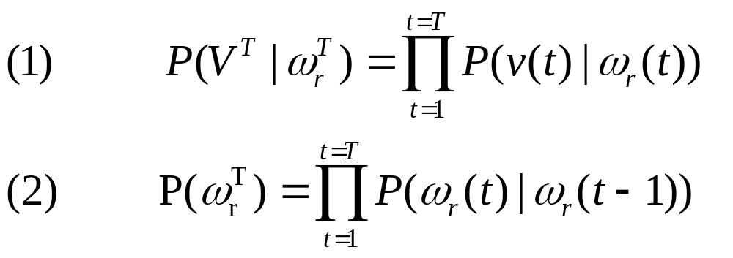
    The evaluation problem
    It is the probability that the model produces a sequence V^{T} of visible states. It is:
    where each r indexes a particular sequence of T
    hidden states.
Patter Classification chapter 3 part 3

Slide 23
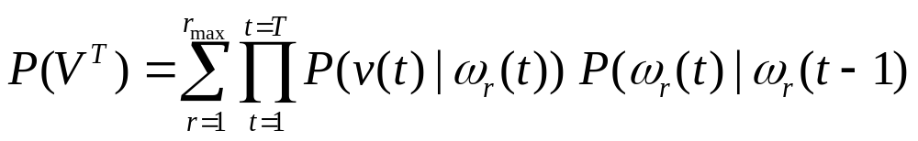
    Using equations (1) and (2), we can write:
    Interpretation: The probability that we observe the particular sequence of T visible states V^{T} is equal to the sum over all r_{max} possible sequences of hidden states of the conditional probability that the system has made a particular transition multiplied by the probability that it then emitted the visible symbol in our target sequence.
    Example: Let ω₁, ω₂, ω₃ be the hidden states; v₁, v₂, v₃ be the visible states
    and V³ = {v₁, v₂, v₃} is the sequence of visible states
    P({v₁, v₂, v₃}) = P(ω₁).P(v₁ | ω₁).P(ω₂ | ω₁).P(v₂ | ω₂).P(ω₃ | ω₂).P(v₃ | ω₃)
    +…+ (possible terms in the sum= all possible (3³= 27) cases !)
Patter Classification chapter 3 part 3

Slide 24
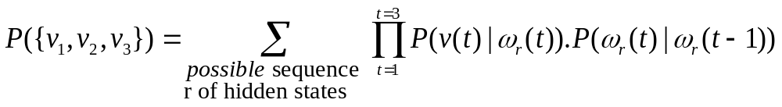
    First case:
    Second case :
    P({v₁, v₂, v₃}) = P(ω₁).P(v₁ | ω₁).P(ω₂ | ω₁).P(v₂ | ω₂).P(ω₃ | ω₂).P(v₃ | ω₃)+
    P(ω₂).P(v₁ | ω₂).P(ω₃ | ω₂).P(v₂ | ω₃).P(ω₁ | ω₃).P(v₃ | ω₁) + …+
    Therefore:
v₁
v₂
v₃
ω₁
(t = 1)
ω₂
(t = 2)
ω₃
(t = 3)
v₁
v₂
v₃
ω₂
(t = 1)
ω₃
(t = 2)
ω₁
(t = 3)
Patter Classification chapter 3 part 3

Slide 25

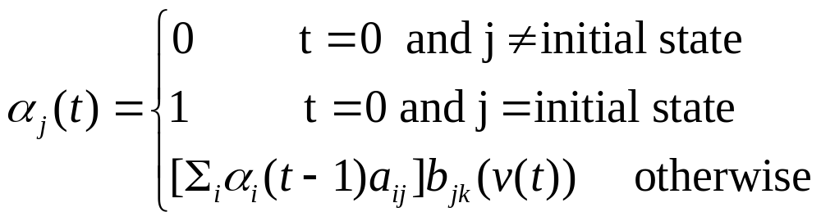
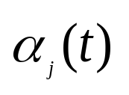
  HMM Forward algorithm
  b_{jk}(v(t)): emission probability b_{jk} selected by the visible state at time t with visible state v(t).
  : probability that HMM is in hidden state ω_{j} at step t having generated the first t elements of V^{T}
Patter Classification chapter 3 part 3

Slide 26
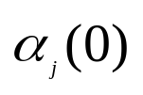
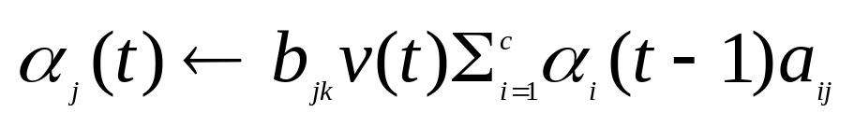
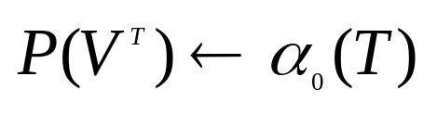
  HMM Forward algorithm
  Initialize t=0, a_{ij,} b_{jk ,} V^{T},
  for t=t+1
  Until t=T
  return for the final state
  end
  A left-to-right HMM
Patter Classification chapter 3 part 3

Slide 27
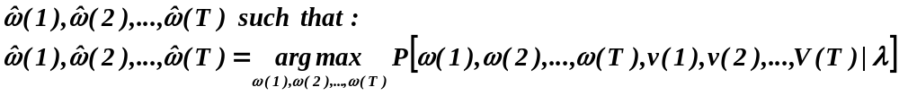
    The decoding problem (optimal state sequence)
    Given a sequence of visible states V^{T}, the decoding problem is to find the most probable sequence of hidden states.
    This problem can be expressed mathematically as:
    find the single “best” state sequence (hidden states)
Note that the summation disappeared, since we want to find
Only one unique best case !
Patter Classification chapter 3 part 3

Slide 28
    Where: λ = [π,A,B]
    π = P(ω(1) = ω) (initial state probability)
    A = a_{ij} = P(ω(t+1) = j | ω(t) = i)
    B = b_{jk} = P(v(t) = k | ω(t) = j)
    In the preceding example, this computation corresponds to the selection of the best path amongst:
    {ω₁(t = 1),ω₂(t = 2),ω₃(t = 3)}, {ω₂(t = 1),ω₃(t = 2),ω₁(t = 3)}
    {ω₃(t = 1),ω₁(t = 2),ω₂(t = 3)}, {ω₃(t = 1),ω₂(t = 2),ω₁(t = 3)}
    {ω₂(t = 1),ω₁(t = 2),ω₃(t = 3)}……
Patter Classification chapter 3 part 3

Slide 29
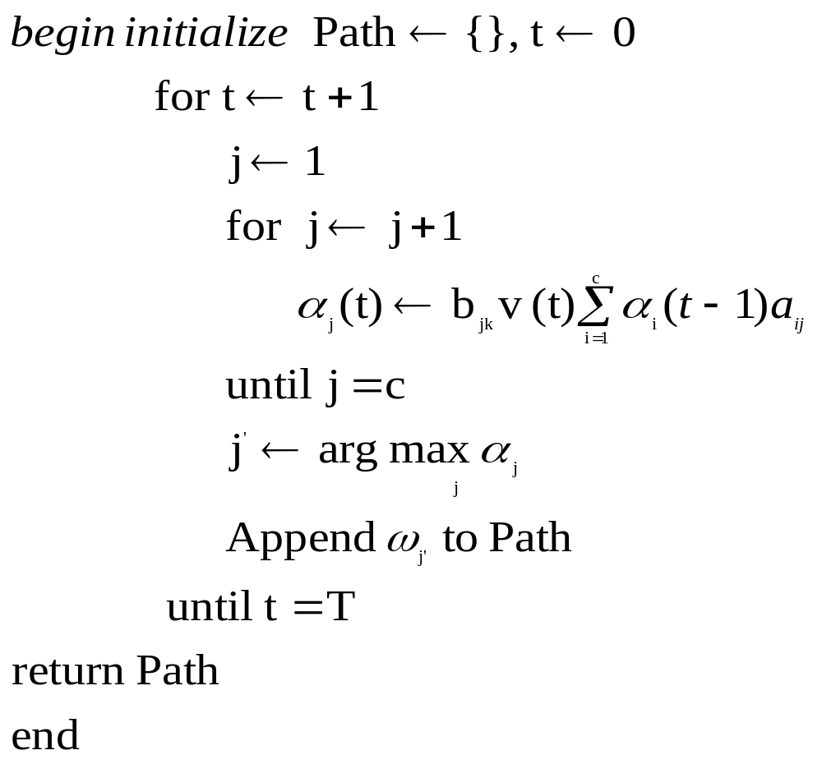
HMM decoding algorithm
Patter Classification chapter 3 part 3

Slide 30
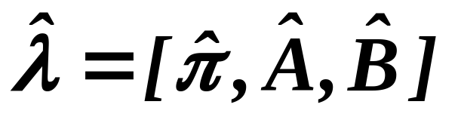
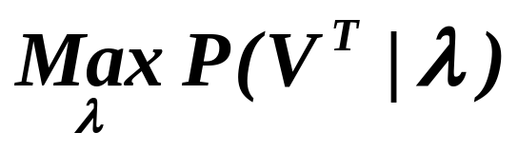
    The learning problem (parameter estimation)
    This third problem consists of determining a method to adjust the model parameters λ = [π,A,B] to satisfy a certain optimization criterion. We need to find the best model
    Such that to maximize the probability of the observation sequence:
    We use an iterative procedure such as Baum-Welch or Gradient to find this local optimum
Patter Classification chapter 3 part 3

Slide 31
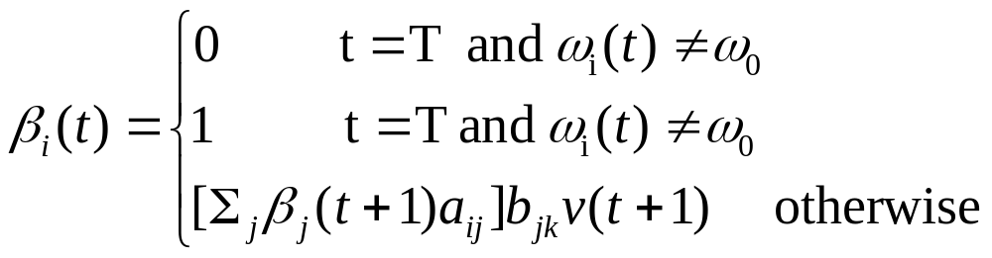
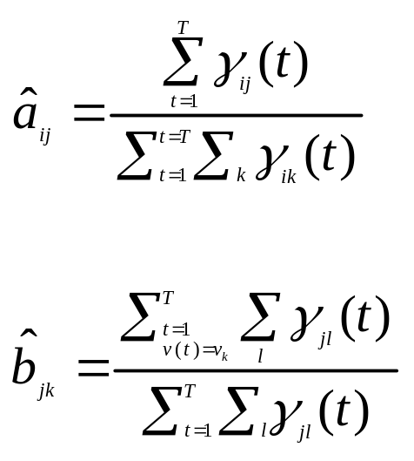
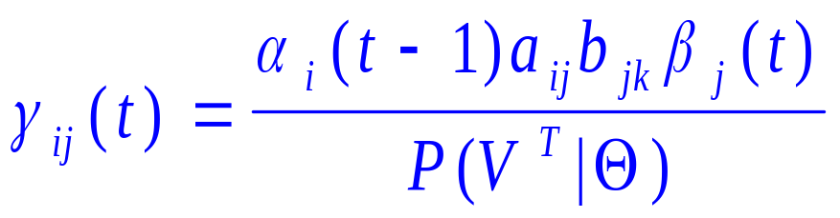
Parameter Updates:
Forward-Backward Algorithm
α_{i}(t)= P( model generates visible sequence up to step t given hidden state ω_{i}(t))
β_{i}(t)= P( model will generate the sequence from t+1 to T given ω_{i}(t))
γij(t) is the probability from ωi(t-1) to ωj(t)
Patter Classification chapter 3 part 3

Slide 32
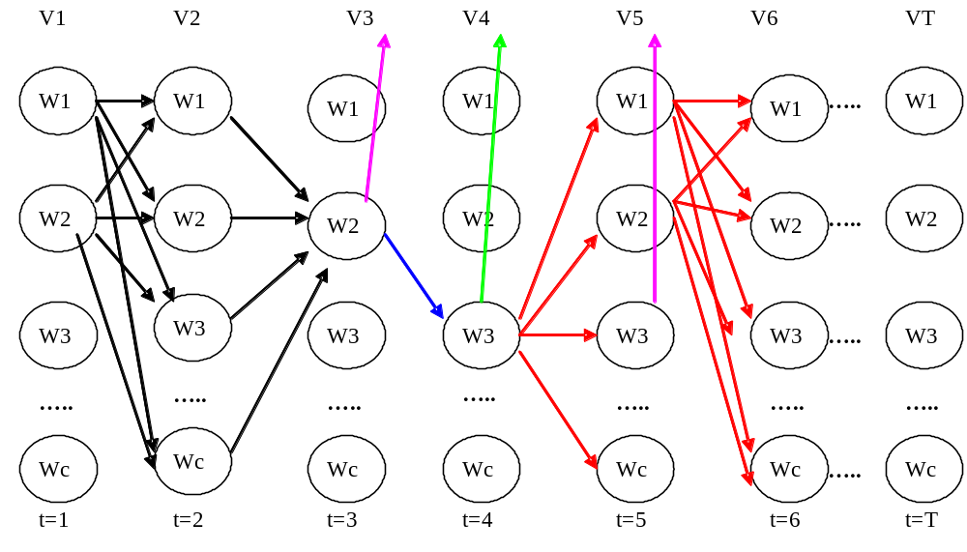
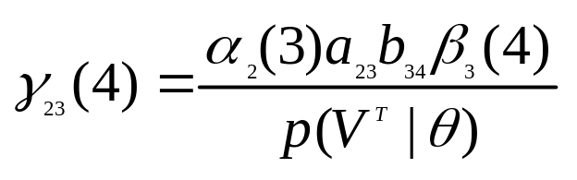
Patter Classification chapter 3 part 3

Slide 33




Parameters Learning Algorithm
Begin initialize
a_{ij}, b_{jk}, training sequence V^{T},
convergence criterion (cc), z=0
Do z=z+1
compute from a(z-1) and b(z-1)
compute from a(z-1) and b(z-1)
a_{ij}(z)=
b_{jk}(z)=
Until max{a_{ij}(z)-a_{ij}(z-1),b_{jk}(z)-b_{jk}(z-1)}< cc
Return a_{ij}=a_{ij}(z); b_{jk}=b_{jk}(z)
End
Patter Classification chapter 3 part 3

Slide 34



Patter Classification chapter 3 part 3

